Slide 1



Interpretable Models for Industrial Processes
UNIVERSITY OF CATANIA
DIPARTIMENTO DI INGEGNERIA ELETTRICA ELETTRONICA E INFORMATICA
MASTER’S DEGREE IN AUTOMATION ENGINEERING AND CONTROL OF COMPLEX SYSTEMS
Candidate
Supervisors
Giuseppa Scipilliti
Prof. Riccardo Caponetto
Prof. Luca Patanè
Prof. Maria Gabriella Xibilia

Slide 2
INTRODUCTION
Black Box solutions have been used to model different industrial processes and represent a valid way to obtain high accuracy, but they are difficult to understand. So, to open the black boxes many researchers started to focus on the model interpretability.
Objective of this work: reaching interpretability of a Sulfur Recovery Unit (SRU) process dataset that comes from a refinery located in Sicily.
Starting idea: implementation of the neuro - fuzzy systems ANFIS and FIS Trees with the extraction of a reduced set of fuzzy rules. These approaches have not satisfied the aim.
Model Agnostic Methods: LIME and Shapley Values have been considered.
The study has been developed in MATLAB.

Slide 3
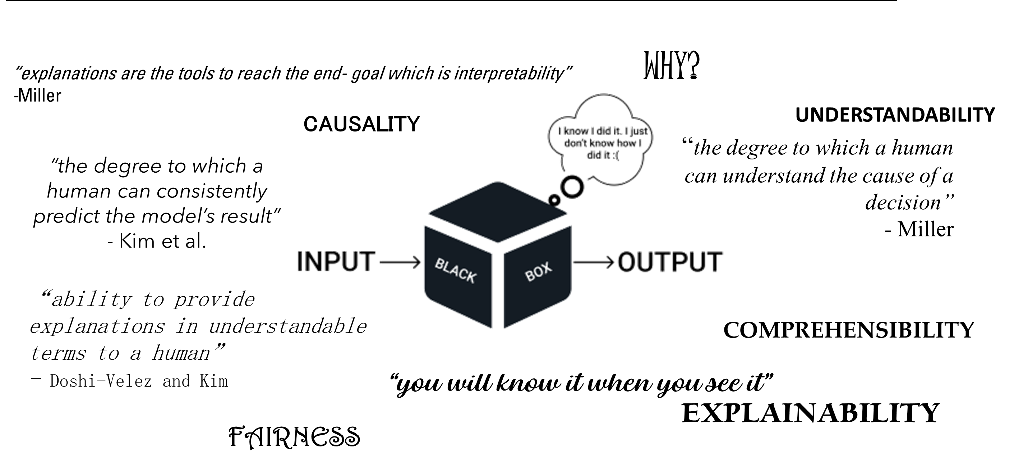
INTERPRETABILITY: not a unique definition

Slide 4
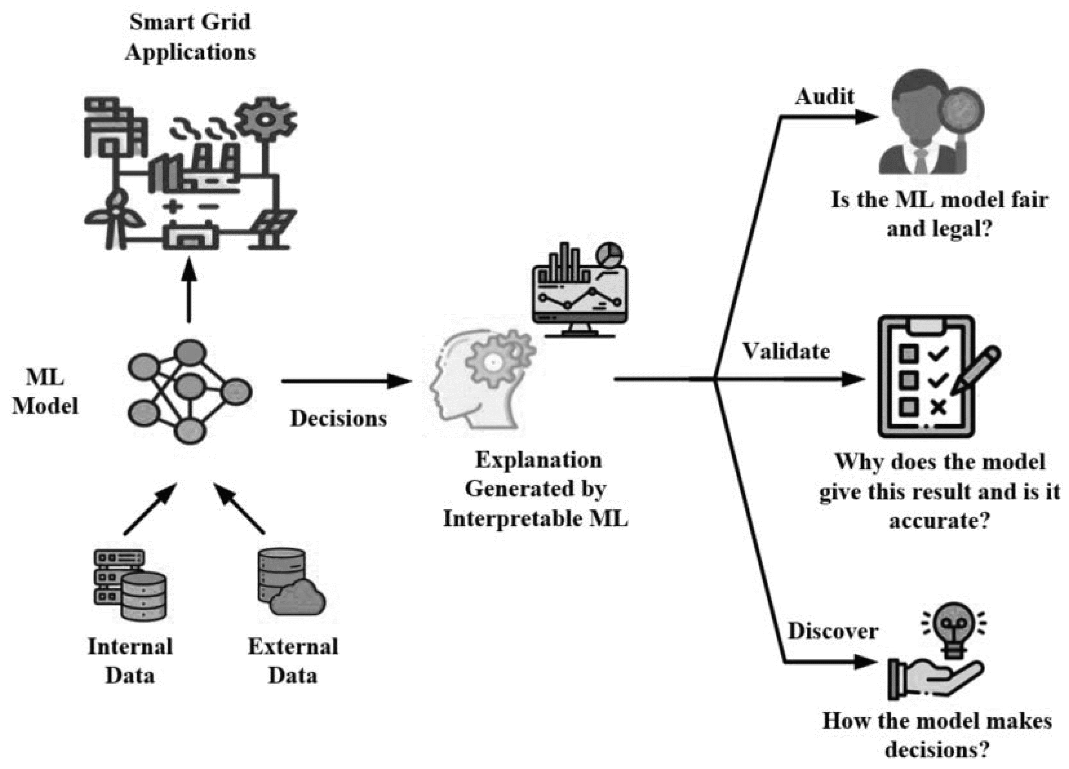
INTERPRETABILITY: the goals
Detect discrimination and bias
Highlight an incompleteness
High Reliability Requirement
Ethical and Legal Requirement
Scientific Usage
Accuracy
Understandability
Efficiency
Trust
Fairness

Slide 5
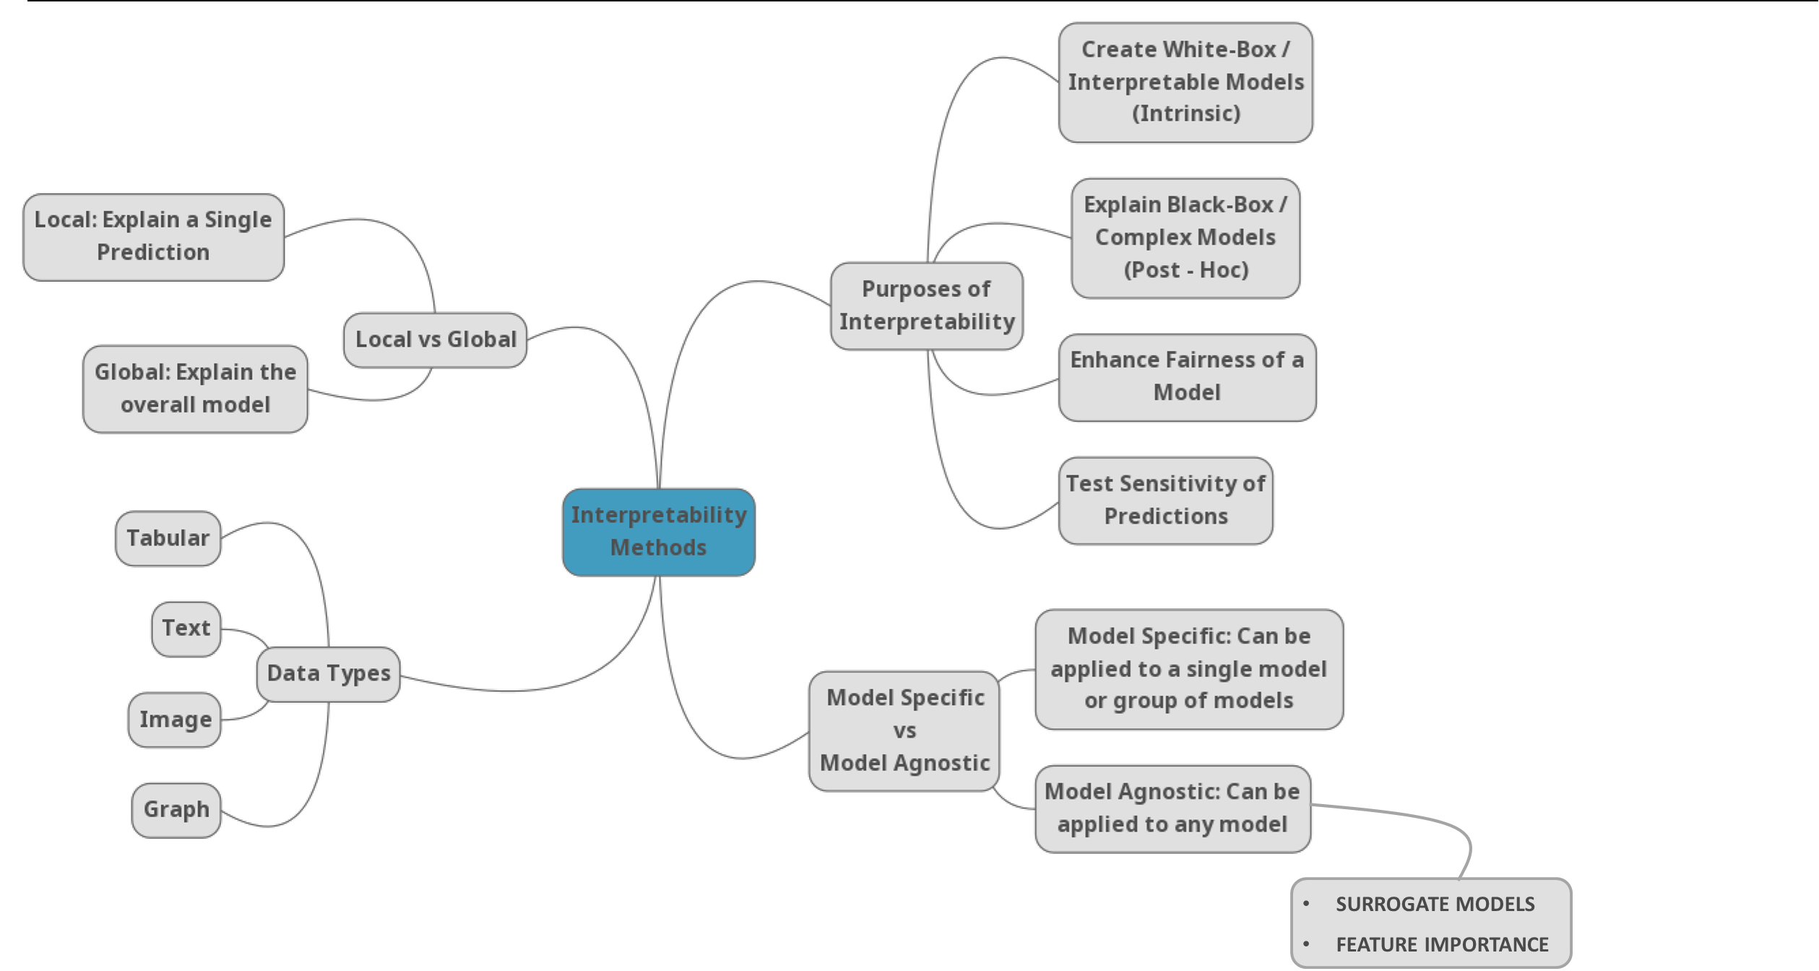
INTERPRETABILITY METHODS: the taxonomy

Slide 6
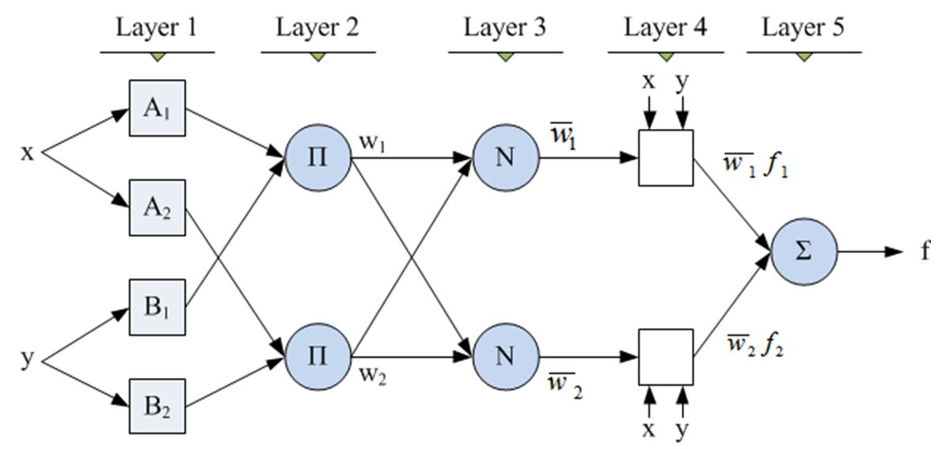
RULE EXTRACTION: Adaptive Neuro-Fuzzy Inference System (ANFIS)
Logic rules are commonly acknowledged to be one of the most interpretable strategy. Thus, rule extraction is an appealing approach to interpret neural networks, essentially trying to reduce their number.
ANFIS is a diffused neuro-fuzzy tool which exploits the Sugeno (TSK) type fuzzy inference system in a five layered network structure. The initial fuzzy model can be derived systematically through few techniques: Subtractive Clustering, Grid Partitioning and Fuzzy C-Means Clustering.

Slide 7
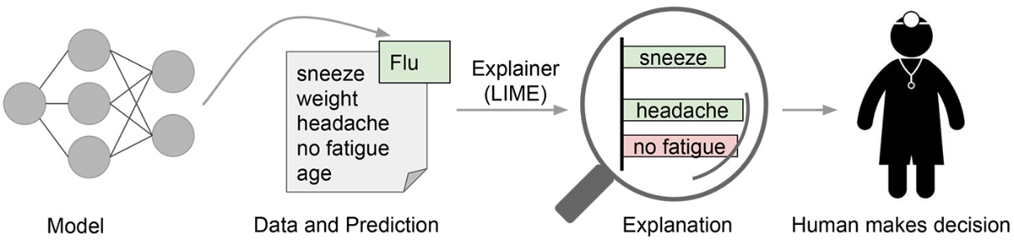
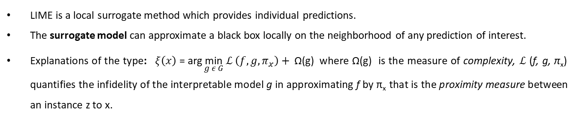
SURROGATE MODELS: Local Interpretable Model-Agnostic Explanations (LIME)
LIME is a local surrogate method which provides individual predictions.
The surrogate model can approximate a black box locally on the neighborhood of any prediction of interest.
Explanations of the type: $ξ\left(x\right) \text{= }\text{arg}\underset{g ε G}{\text{min}}{ℒ \left(f, g, π_{x}\right)+ }\text{Ω(}\text{g}\text{)}$ where Ω(g) is the measure of complexity, $ℒ$ (f, g, π_{x}) quantifies the infidelity of the interpretable model g in approximating f by π_{x} that is the proximity measure between an instance z to x.

Slide 8
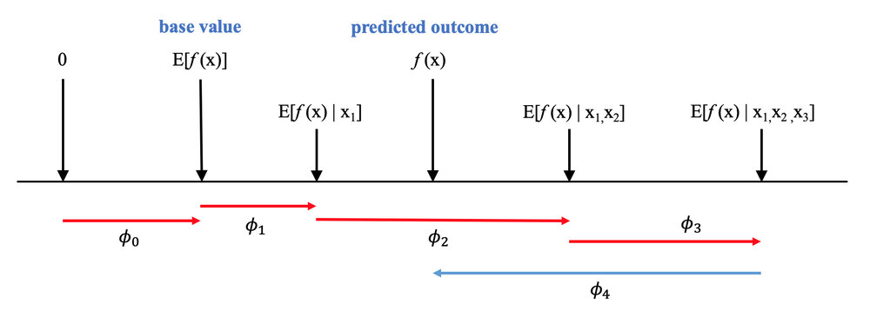
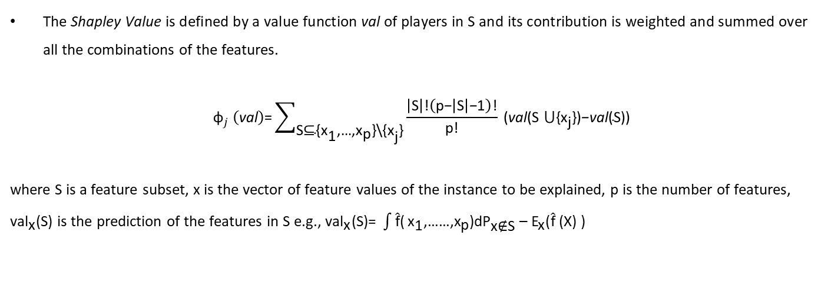
FEATURE IMPORTANCE approach: Shapley Values
The Shapley value is the average marginal contribution of a feature value across all possible coalitions. To each feature is assigned a Shapley Value for a specific prediction for calculating the explanation.
The Shapley Value is defined by a value function val of players in S and its contribution is weighted and summed over all the combinations of the features.
$${\text{ϕ}}_{j} \left(\text{val}\right)\text{=}\sum_{\text{S}\text{⊆}\text{\{}{\text{x}}_{\text{1}}\text{,…,}{\text{x}}_{\text{p}}\text{\}\backslash }\text{\{}{\text{x}}_{\text{j}}\text{\}}}{\frac{\left|\text{S}\right|\text{!}\left(\text{p}\text{−}\left|\text{S}\right|\text{−}\text{1}\right)\text{!}}{\text{p}\text{!}}}\text{ (}\text{val}\text{(}\text{S}\text{ ⋃\{}{\text{x}}_{\text{j}}\text{\})}\text{−}\text{val}\text{(}\text{S}\text{))}$$
where S is a feature subset, x is the vector of feature values of the instance to be explained, p is the number of features, ${\text{val}}_{\text{x}}\text{(}\text{S}\text{)}$ is the prediction of the features in S e.g., ${\text{val}}_{\text{x}}\text{(}\text{S}\text{)= }\int{\hat{\text{f}}\text{(}}{\text{x}}_{\text{1}}\text{,……,}{\text{x}}_{\text{p}}\text{)}\text{d}{\text{P}}_{\text{x}\text{∉}\text{S}}{\text{ – }\text{E}}_{\text{x}}\text{(}\hat{\text{f}}\text{ (}\text{X}\text{) )}$

Slide 9
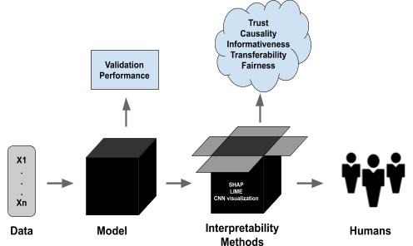
LIME
Shapley Values
LIME is a local surrogate method which provides individual predictions.
Single prediction explanation.
There is not a fair distribution for each variable.
Creation of a surrogate model, considered as linear.
Property of additivity.
Low computing time.
Difference between the prediction with and without a variable.
To each feature is assigned a Shapley Value for a specific prediction for calculating the explanation.
Consinstency: for entire model (or single variable) explanation.
Fair distribution of contribution for each variable.
Efficiency, symmetry, dummy, additivity.
High computing time: there are 2^{k} possible coalitions of the features.
Contribution of a variable to the difference between the actual prediction and the mean prediction.

Slide 10
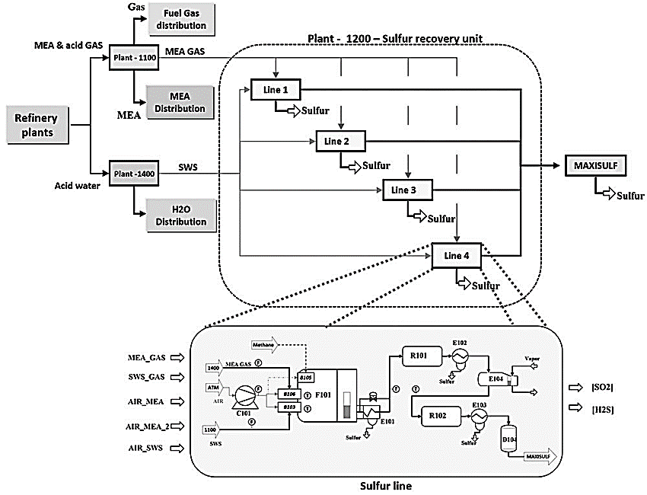
Case of Study: the dataset
The dataset comes from a Sulfur Recovery Unit (SRU) process of a refinery plant located in Sicily.
5 Inputs, 1 output (combination of the process’ outputs) and 10081 samples:
IN1: MEA_GAS;
IN2: SWS_GAS;
IN3: AIR_MEA;
IN4: AIR_SWS;
IN5: AIR_MEA_2;

Slide 11
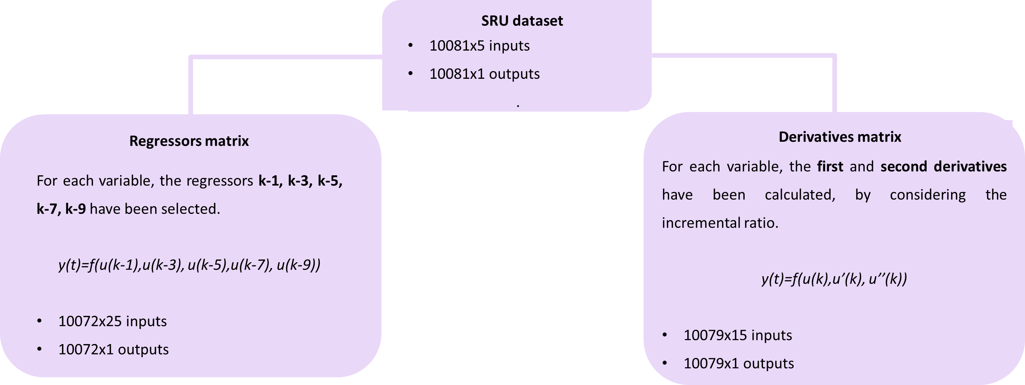
Case of Study: the matrices of interest
Since the process is dynamic the inputs include regressors. As an alternative to this, in order to make the results more interpretable, it was decided to replace the regressors with the first and second derivatives, effectively making an approximation of the model to a non-linear second-order system.

Slide 12
Case of Study: the objectives and the approaches
Objective: reaching interpretability for the peaks’ samples of the output variable.
Starting idea: implementation of a neuro - fuzzy system and extraction of a reduced set of fuzzy rules.
- ANFIS using Subtractive Clustering
- ANFIS using FCMClustering
- FIS trees
Model Agnostic Methods: LIME and Shapley Values have been considered.
The study has been developed in MATLAB.
The output of the SRU dataset with the most important peaks.

Slide 13
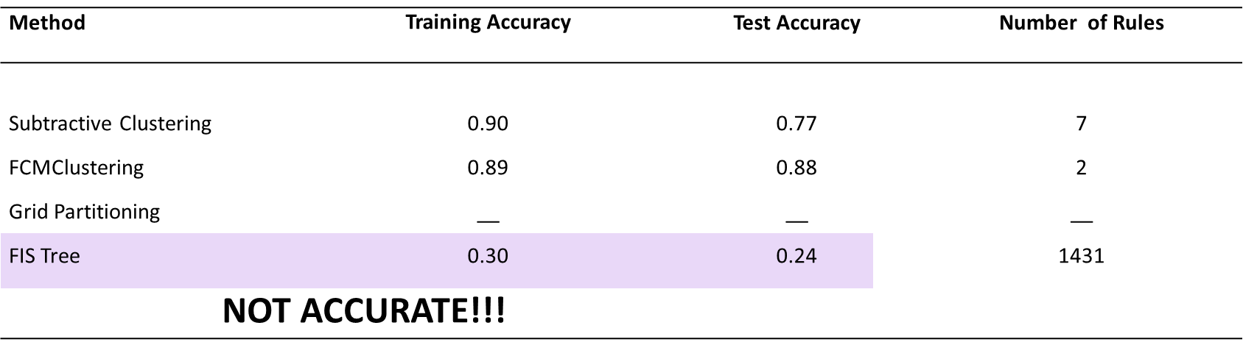
Neuro – fuzzy approaches: Regressors matrix
ANFIS with Subtractive Clustering: clusterInfluenceRange from 0.3 to 1 with a step size of 0.01.
ANFIS with FCMClustering: numClusters from 2 to 25.
ANFIS with Grid Partitioning: number of variables too high!!
FIS Tree: aggregated tree with 5 FIS (each FIS has 5 inputs).
Not suitable for large number of variables;
Few rules and/or without any interpretable sense;
Low accuracy for FIS Trees.
If (in1 is in1cluster1) and (in2 is in2cluster1) and (in3 is in3cluster1) and (in4 is in4cluster1) and (in5 is in5cluster1) and (in6 is in6cluster1) and (in7 is in7cluster1) and (in8 is in8cluster1) and (in9 is in9cluster1) and (in10 is in10cluster1) and (in11 is in11cluster1) and (in12 is in12cluster1) and (in13 is in13cluster1) and (in14 is in14cluster1) and (in15 is in15cluster1) and (in16 is in16cluster1) and (in17 is in17cluster1) and (in18 is in18cluster1) and (in19 is in19cluster1) and (in20 is in20cluster1) and (in21 is in21cluster1) and (in22 is in22cluster1) and (in23 is in23cluster1) and (in24 is in24cluster1) and (in25 is in25cluster1) then (out1 is out1cluster1)
NOT INTERPRETABLE!!!

Slide 14
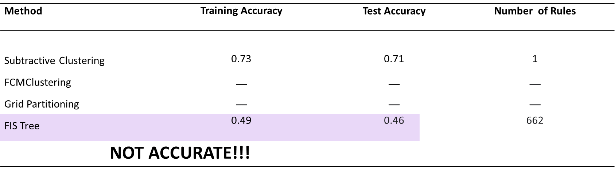
Neuro – fuzzy approaches: Derivatives matrix
ANFIS with Subtractive Clustering: clusterInfluenceRange from 0.3 to 1 with a step size of 0.01
ANFIS with FCMClustering: not implemented, some inputs were almost the same for all samples.
ANFIS with Grid Partitioning: number of variables too high!!
FIS Tree: aggregated tree with 3 FIS (each FIS has 5 inputs).
Not suitable for large number of variables;
Few rules and/or without any interpretable sense;
Low accuracy for FIS Trees.
If (in1 is in1cluster1) and (in2 is in2cluster1) and (in3 is in3cluster1) and (in4 is in4cluster1) and (in5 is in5cluster1) and (in6 is in6cluster1) and (in7 is in7cluster1) and (in8 is in8cluster1) and (in9 is in9cluster1) and (in10 is in10cluster1) and (in11 is in11cluster1) and (in12 is in12cluster1) and (in13 is in13cluster1) and (in14 is in14cluster1) and (in15 is in15cluster1) then (out1 is out1cluster1)
NOT INTERPRETABLE!!!

Slide 15
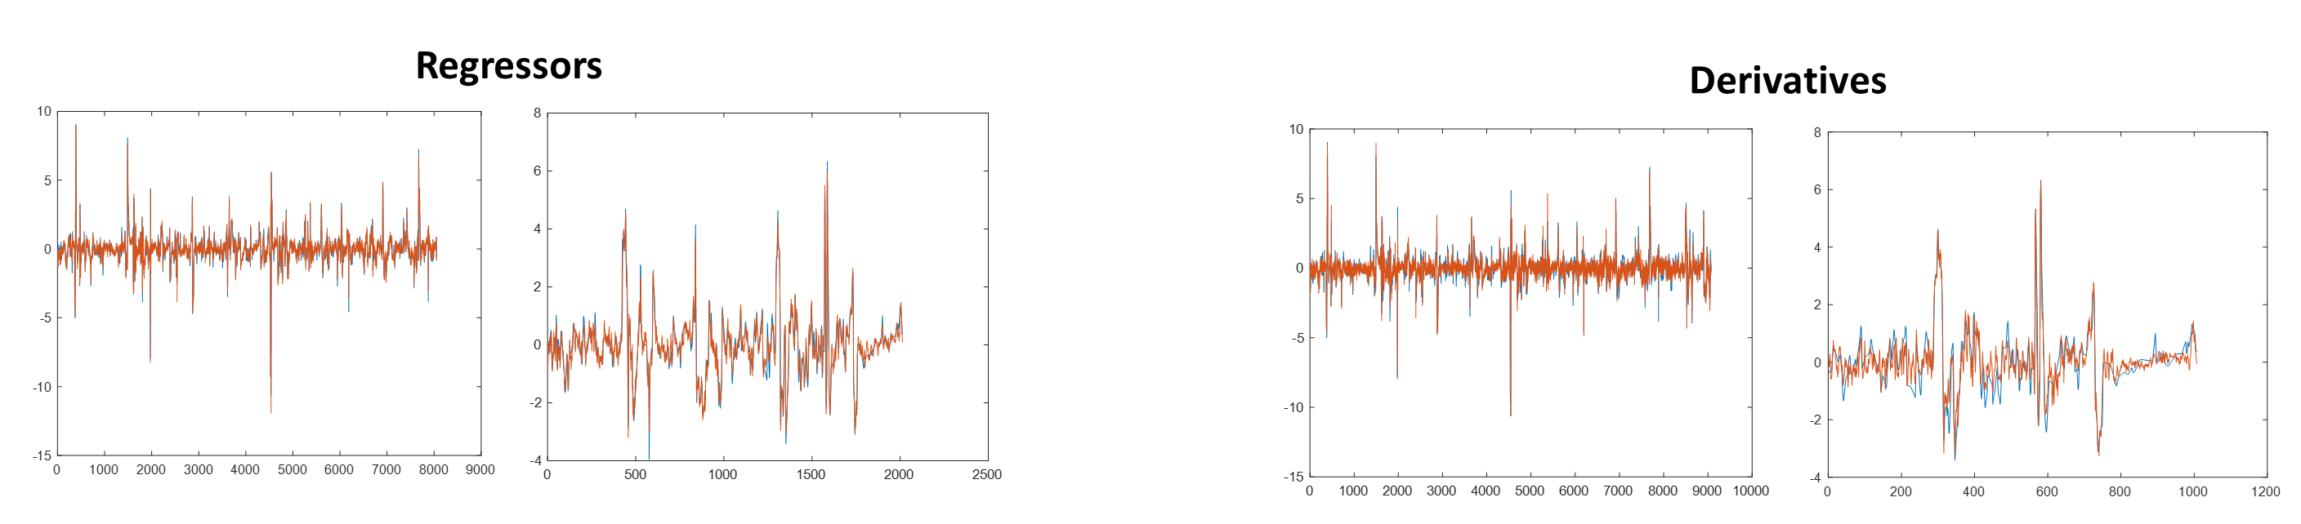
LIME and Shapley Values: the Black Box
For these reasons, LIME and Shapley Values methods have been considered, by implementing as black box a Regression Neural Network (RNN) obtained after the optimization of the hyperparameters.

Slide 16
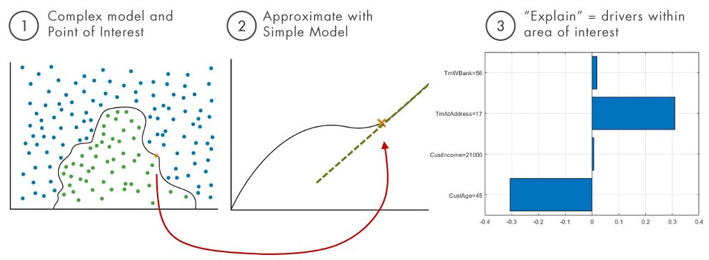
LIME in MATLAB
It explains a prediction of a regression model for a query point by creating a synthetic dataset and generating a simple interpretable model of important predictors. So, the simple model explains the predictions for the synthetic data around the query point.
Since the aim is to control the outputs’ peaks, the most important ones have been individuated as query points.

Slide 17
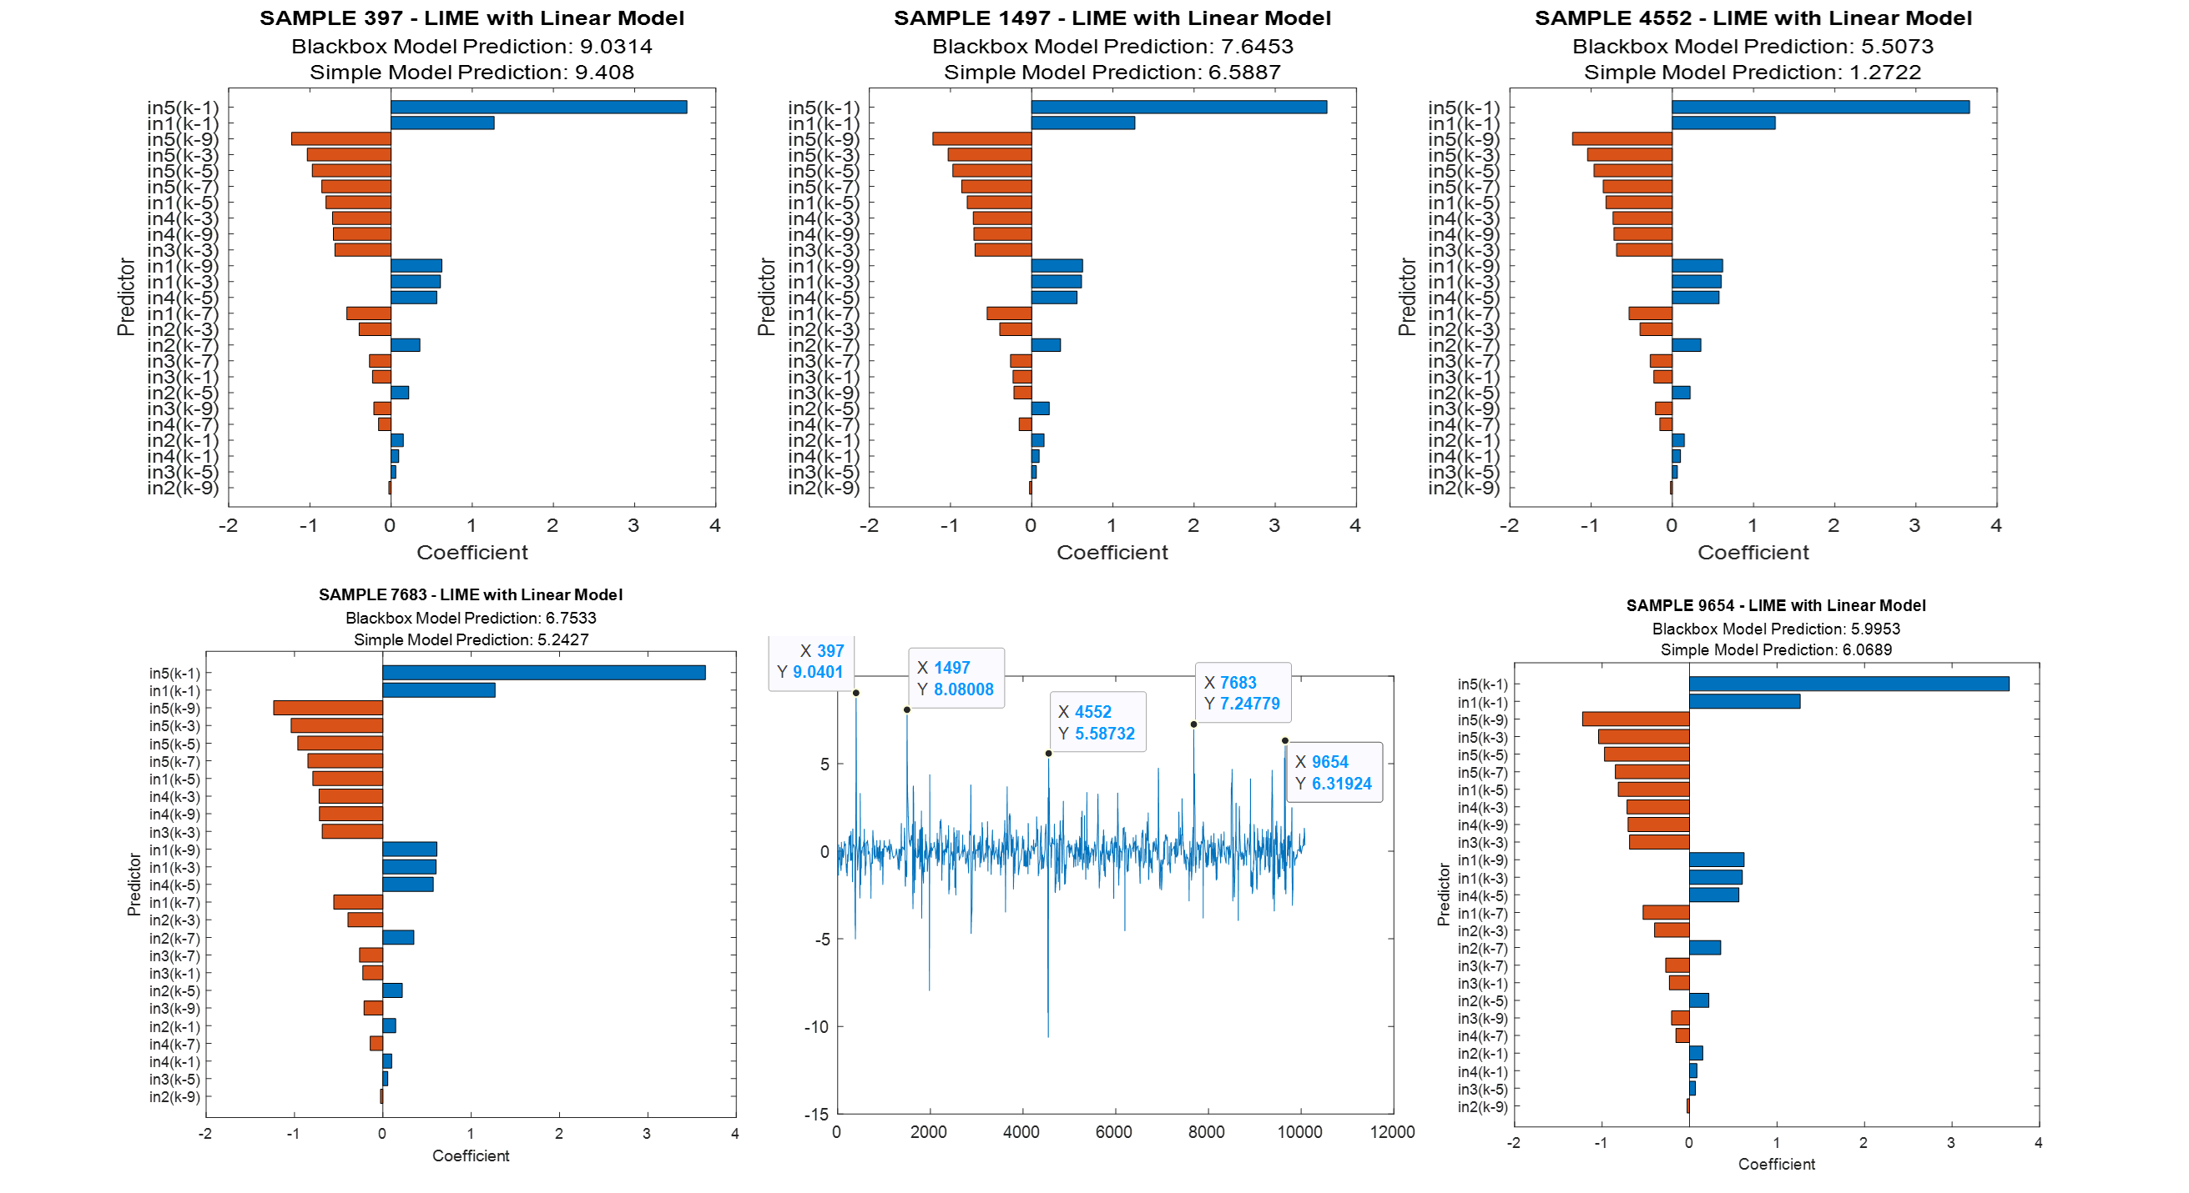
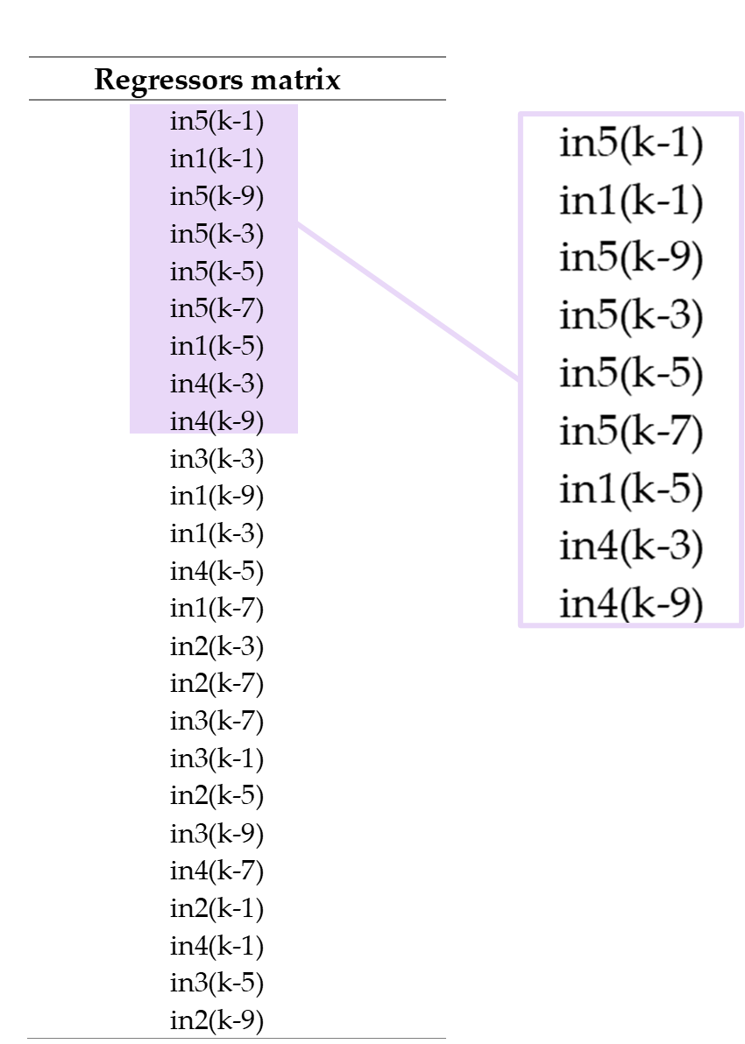
LIME: Regressors

Slide 18
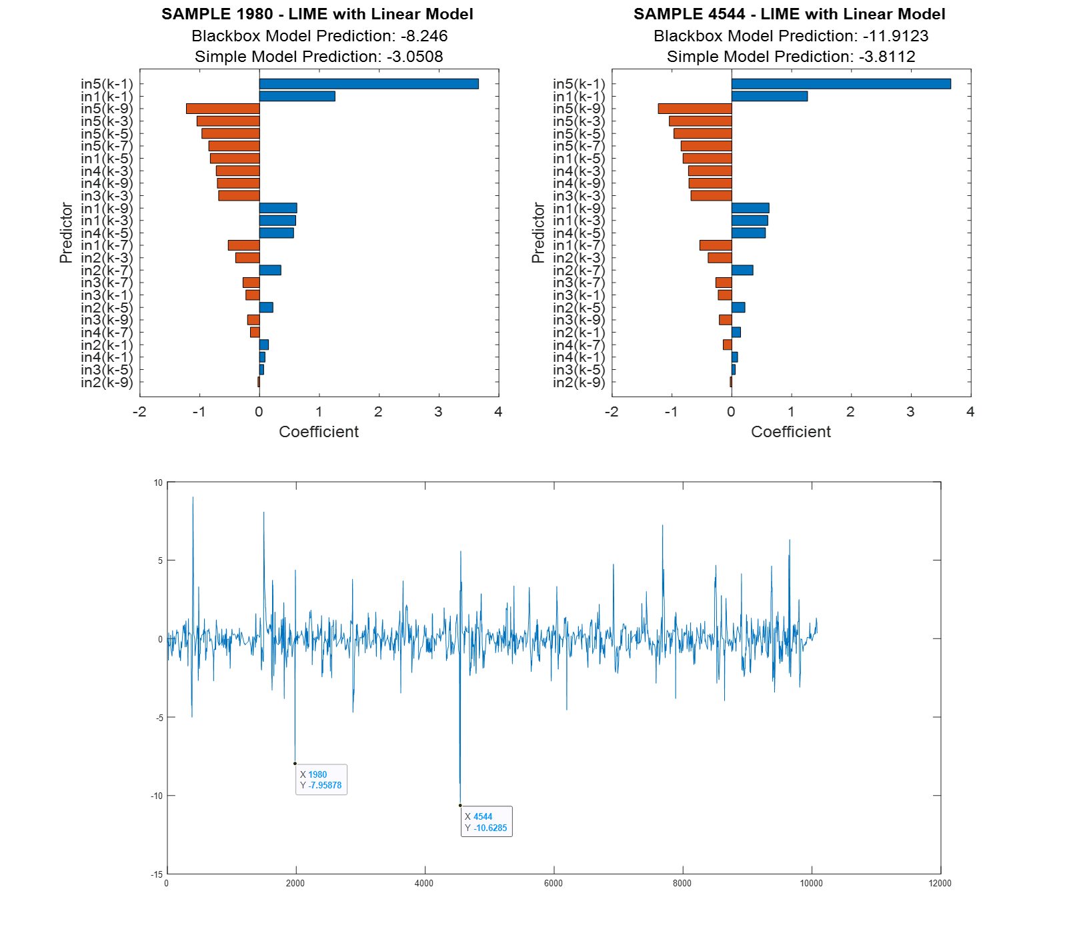
LIME: Regressors

Slide 19
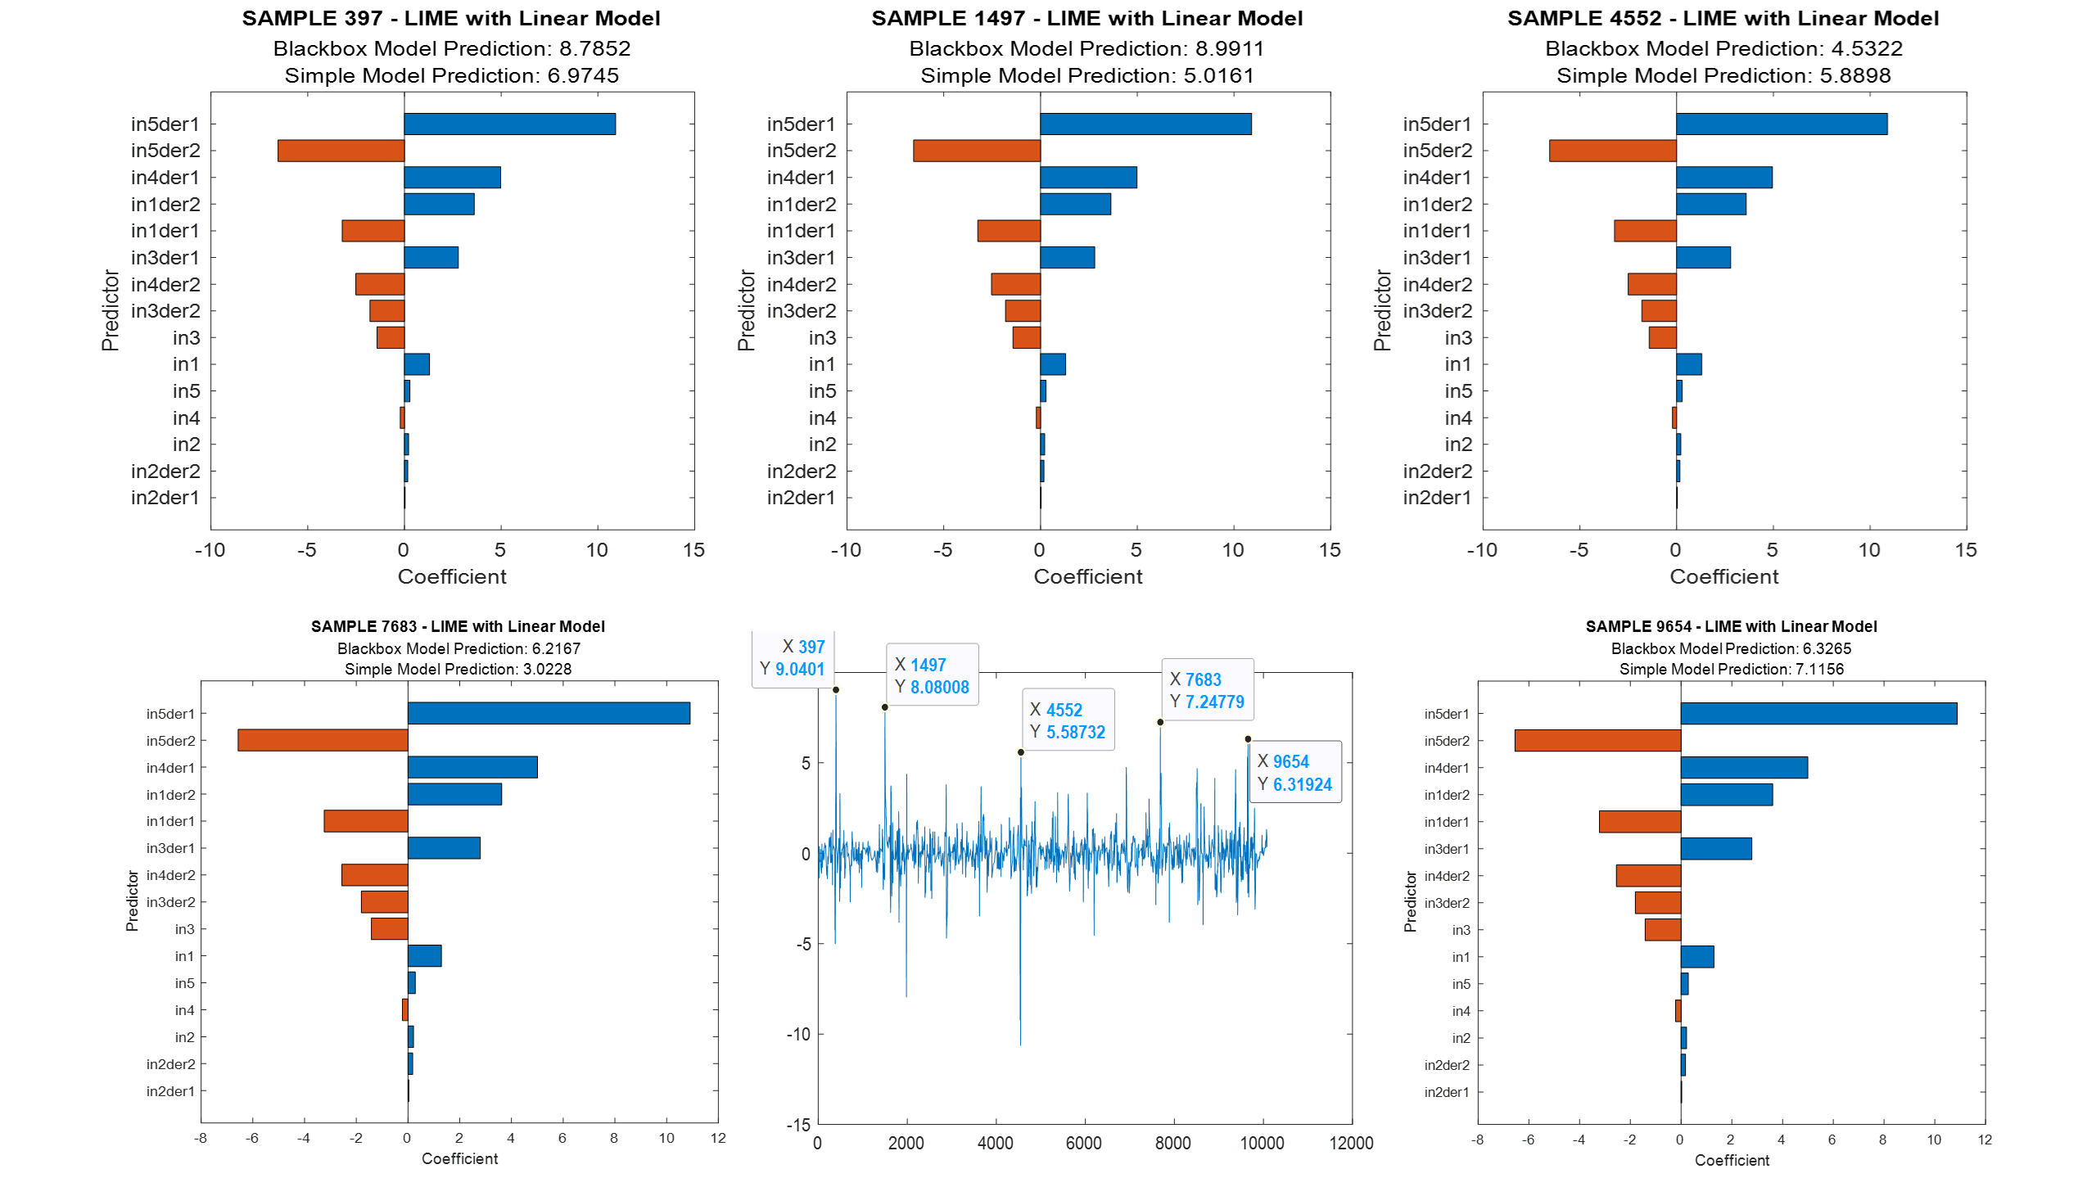
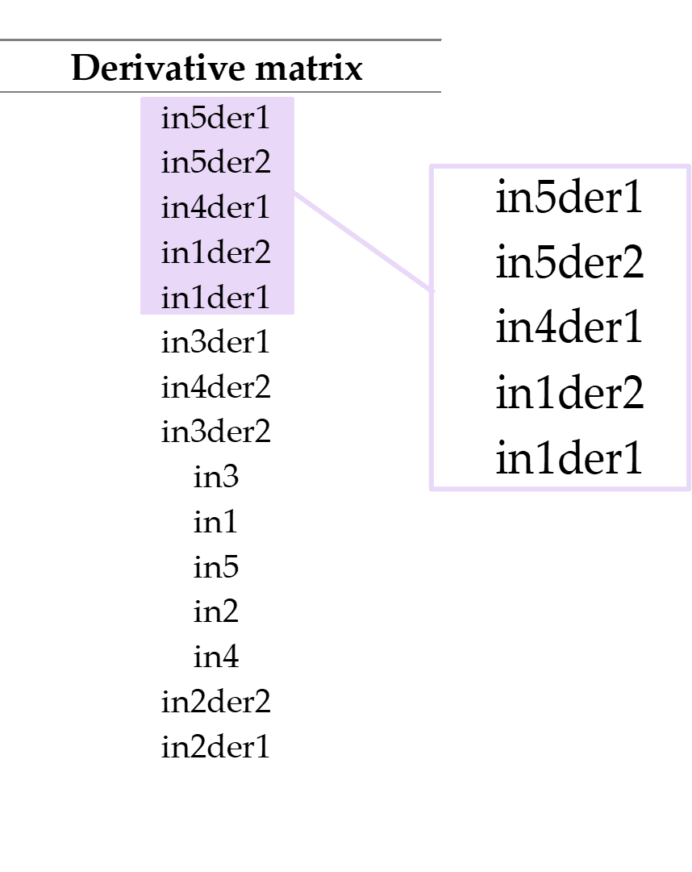
LIME: Derivatives

Slide 20
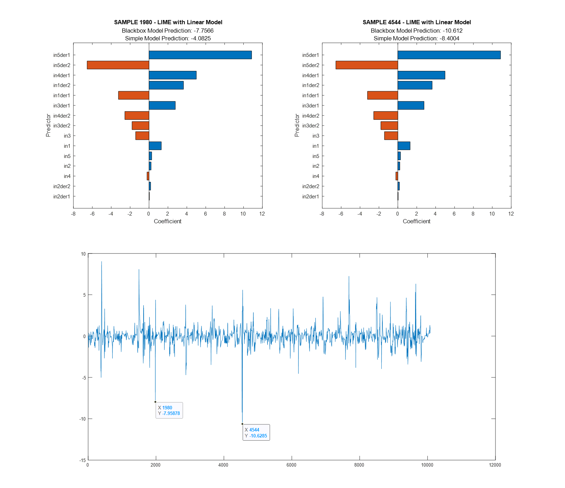
LIME: Derivatives

Slide 21
LIME: Regressors vs. Derivatives
In both cases, AIR_MEA_2 , MEA_GAS, AIR_SWS (in5, in1 and in4) of the SRU dataset appear in the first positions as Important Predictors.

Slide 22
Shapley Values in MATLAB
The Shapley value of a feature for a query point is the contribution of the feature to the deviation from the average prediction.
For a query point, the sum of the Shapley values for all features corresponds to the total deviation of the prediction from the average.
The sum of the average prediction and the Shapley values for all features corresponds to the prediction for the query point.
Since the aim is to control the outputs’ peaks, the most important ones have been individuated as query points.

Slide 23
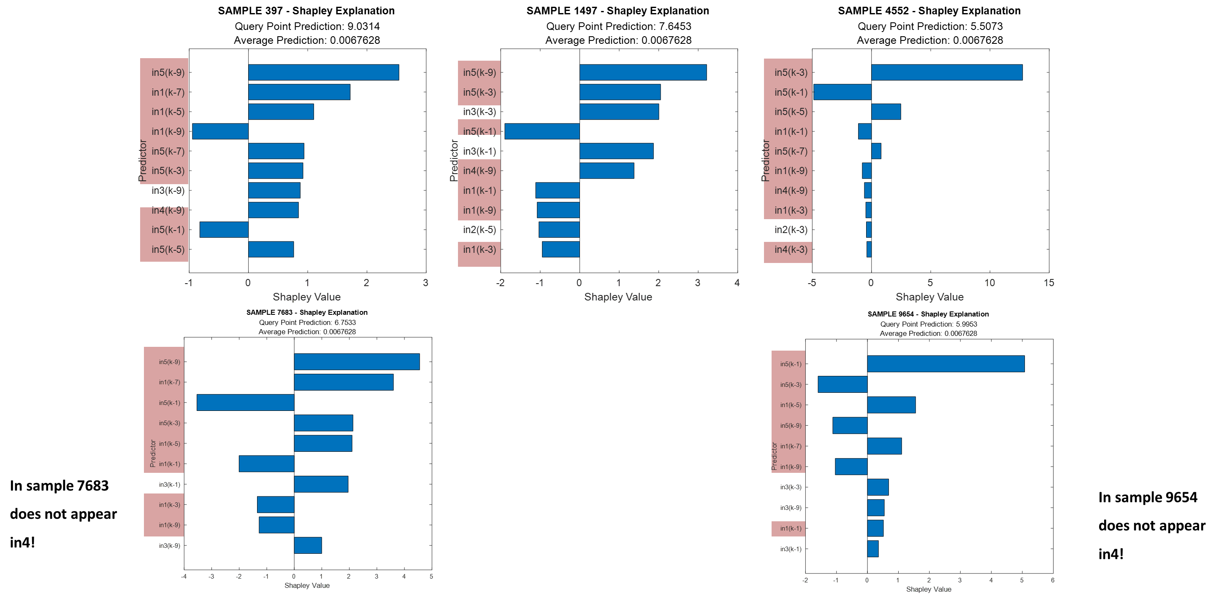
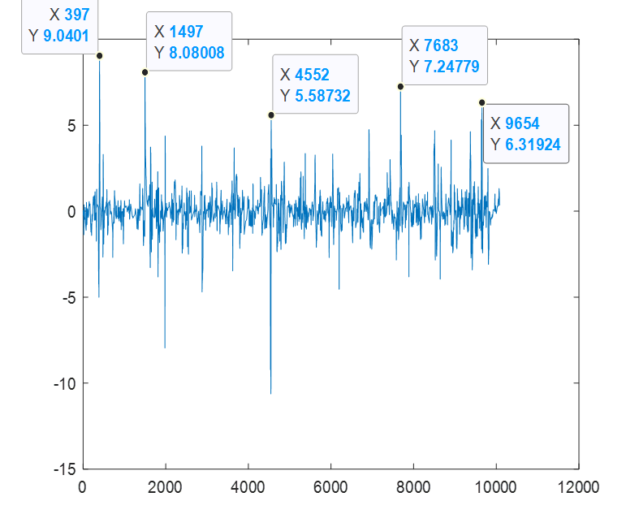
Shapley Values: Regressors

Slide 24
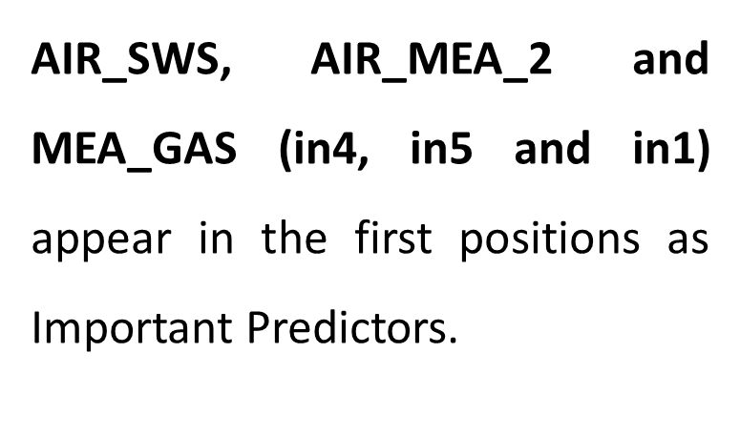
Shapley Values: Regressors

Slide 25
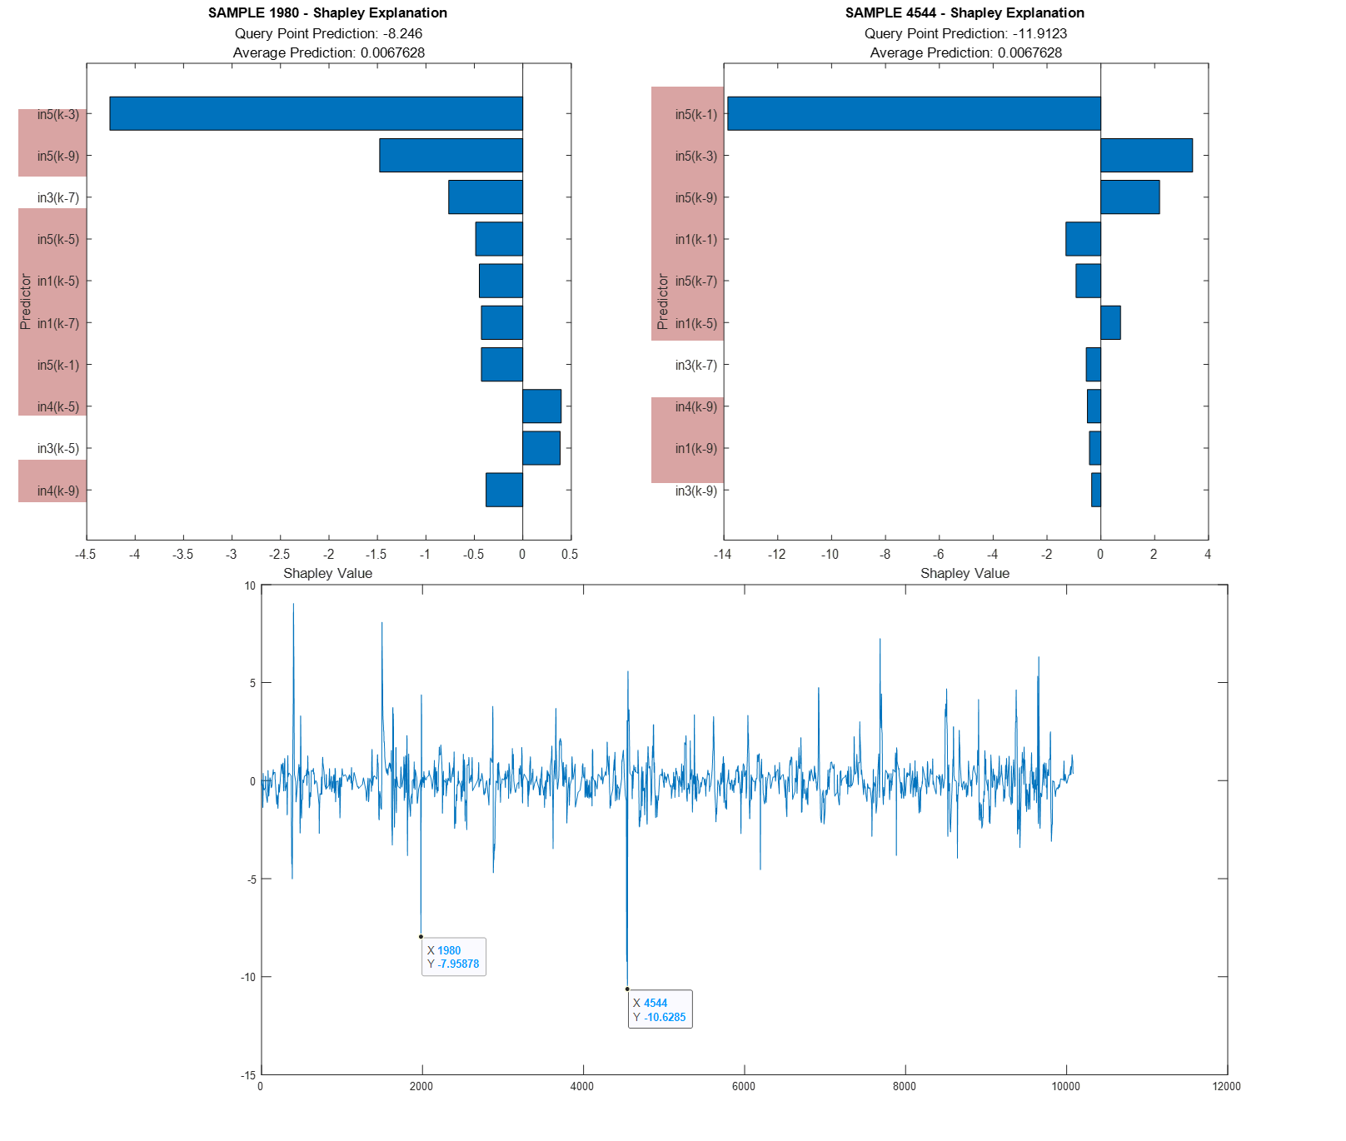
Shapley Values: Regressors
AIR_MEA_2, MEA_GAS, AIR_SWS (in5, in1 and in4) appear in the first positions as Important Predictors.

Slide 26
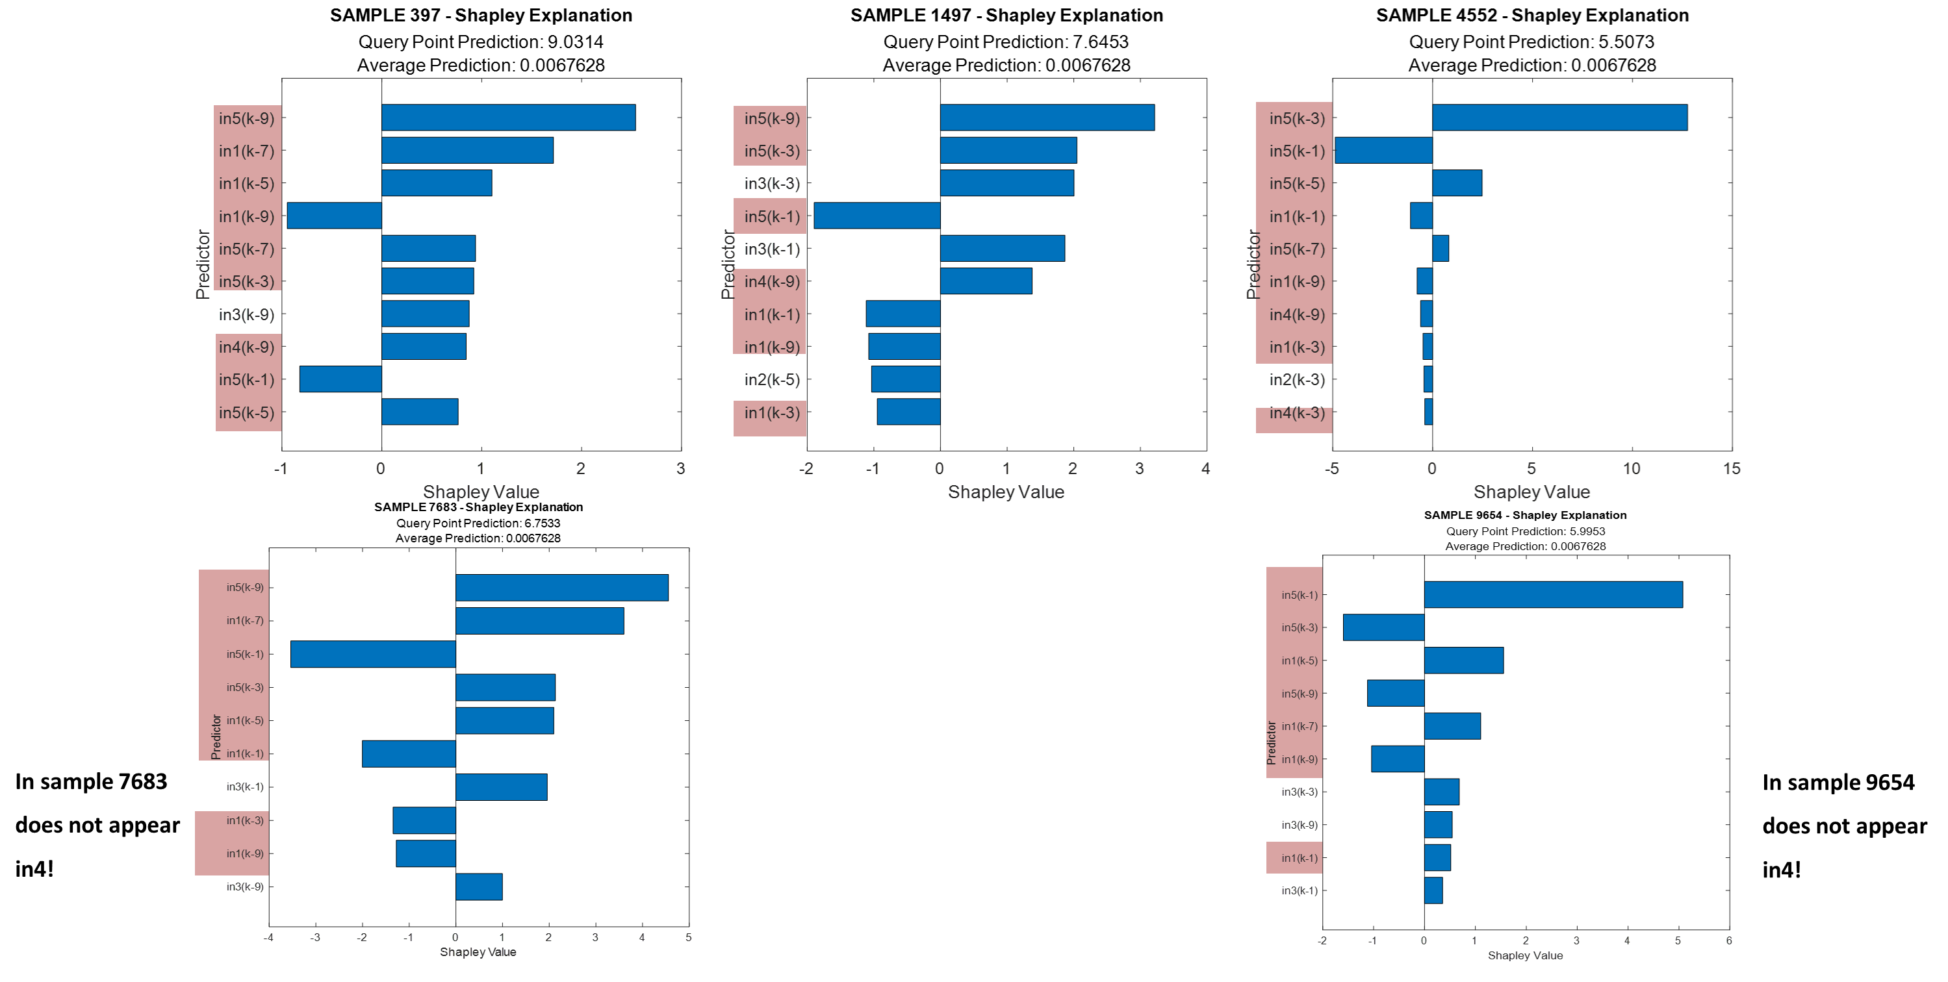
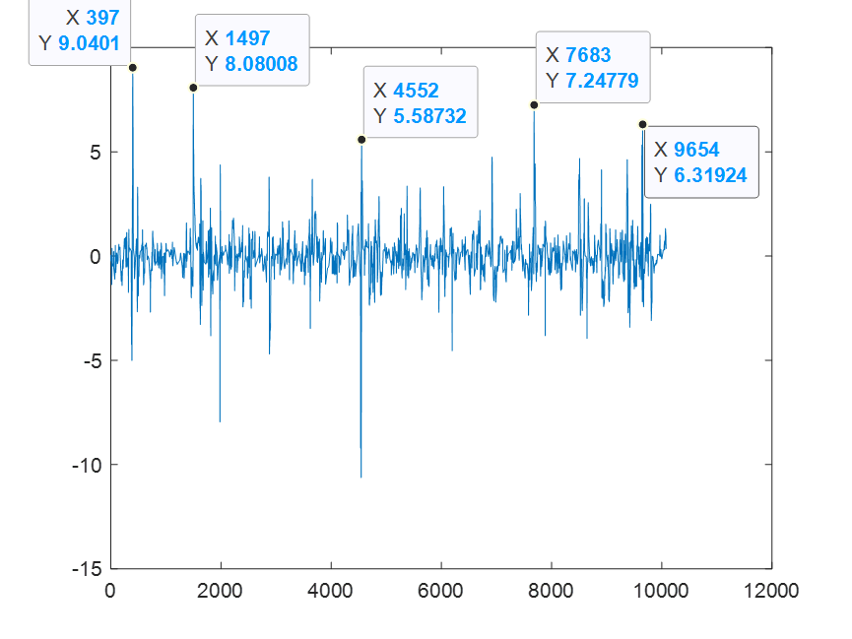
Shapley Values: Derivatives

Slide 27
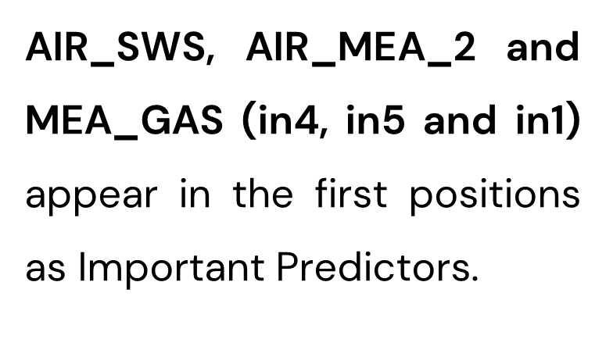
Shapley Values: Derivatives

Slide 28
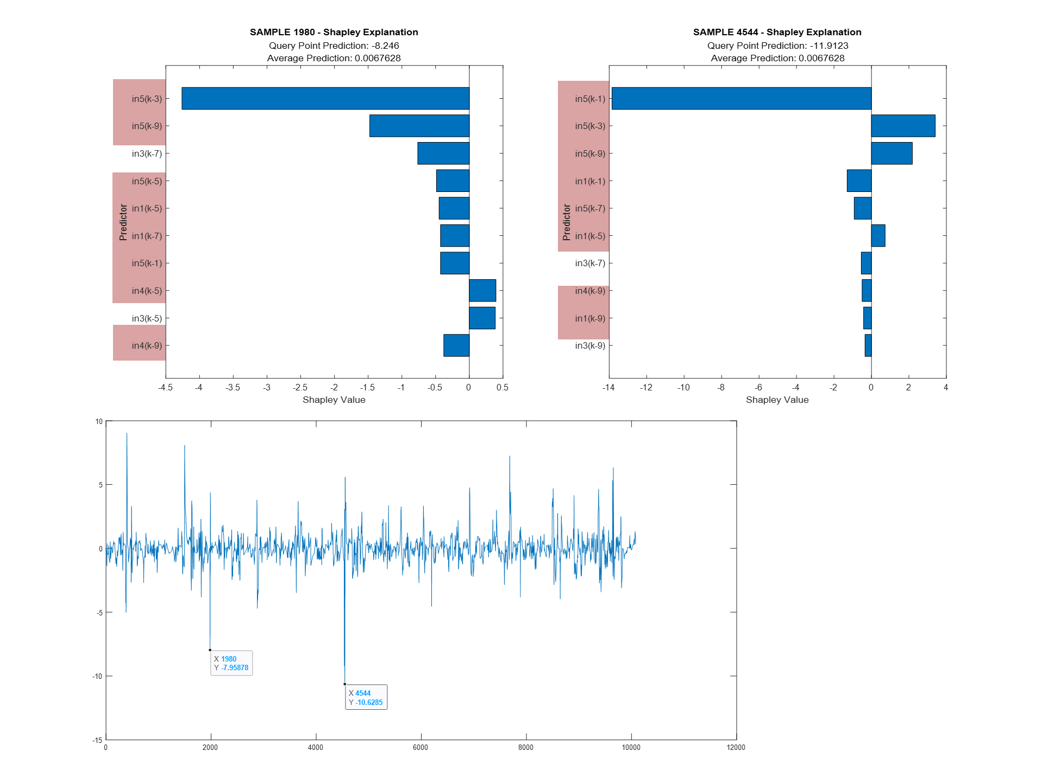
Shapley Values: Derivatives
AIR_MEA_2, MEA_GAS, AIR_SWS (in5, in1 and in4) appear in the first positions as Important Predictors.

Slide 29
Conclusions
Method | Accuracy |  | Interpretability
Subtractive Clustering FCMClustering Grid Partitioning FIS Tree LIME Shapley Values |  | ✓ __ __ ✗ ✓ ✓ | ✗ __ __ __ ✓ ✓
Neuro- fuzzy approaches did not provide interpretable results.
The second part of the project allowed to understand effectively what the accurate RNN black box contains, by considering the LIME and Shapley Values approaches.
The fifth, the first and the fourth variables, AIR_MEA_2, MEA_GAS, and AIR_SWS of the SRU dataset are the ones which appeared more constantly, they are the most important predictors.
The matrix of the derivatives, although containing a reduced order as respect to the regressors one, can provide the same important predictors.

Slide 30
THANK YOU FOR THE ATTENTION

